Slide 1

Gravitational Force of Magnets

Slide 2
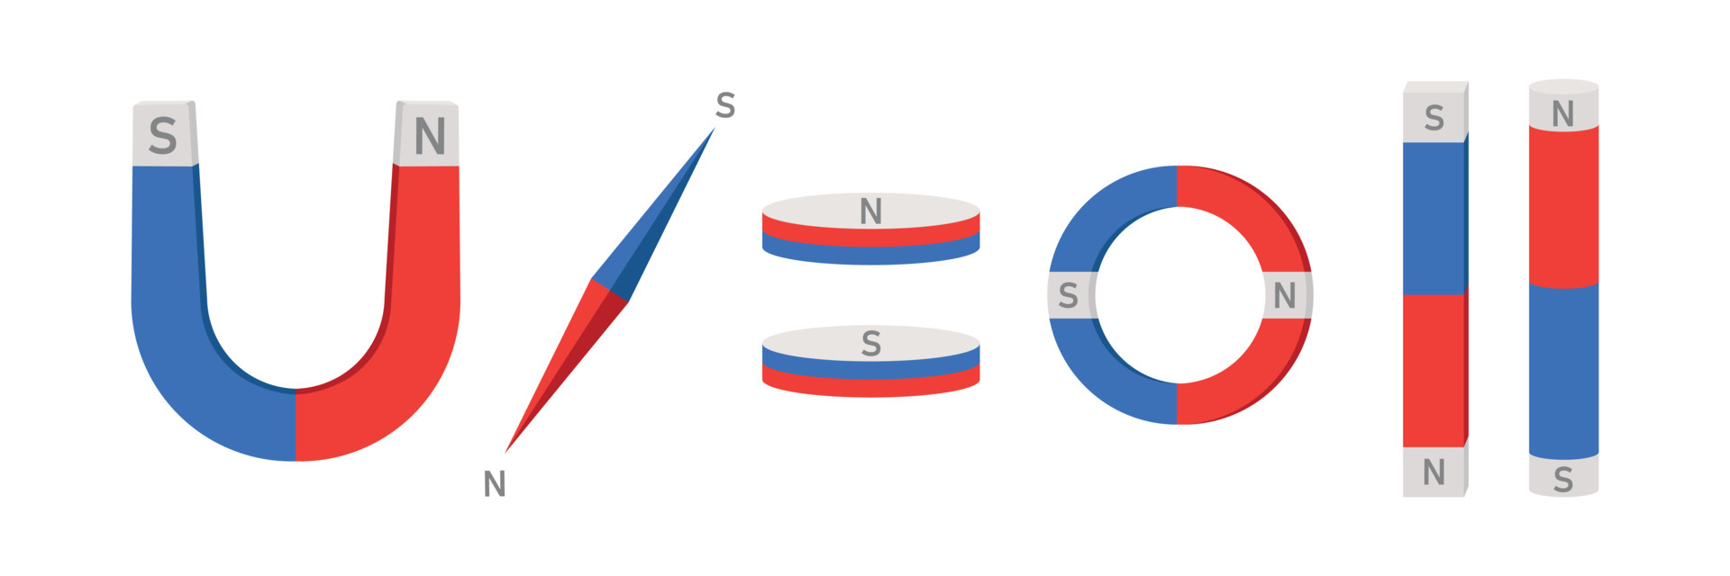
Objects that attract substances such as iron, nickel and cobalt are called magnets. Magnets can be found in different shapes. The most well-known shapes are bar, U shape and round shape.

Slide 3
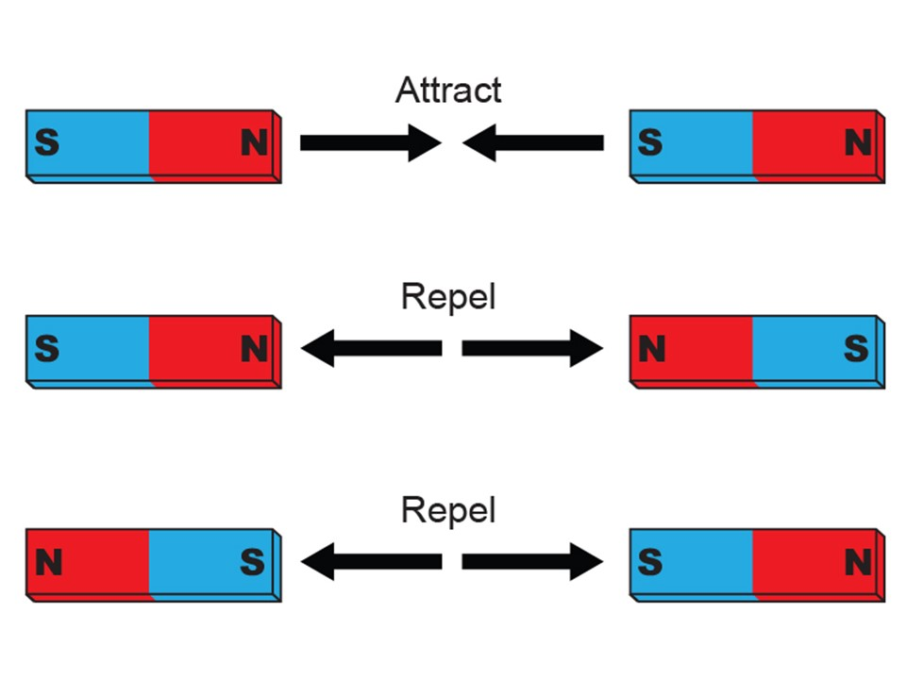
A magnet can exert force without contact. It has two poles. The North Pole is denoted by the letter N and the South Pole by the letter S. The the same poles repel each other, whereas different poles attract each other.

Slide 4
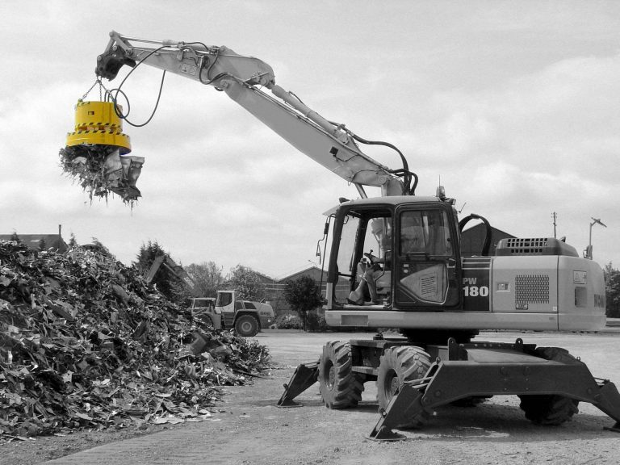
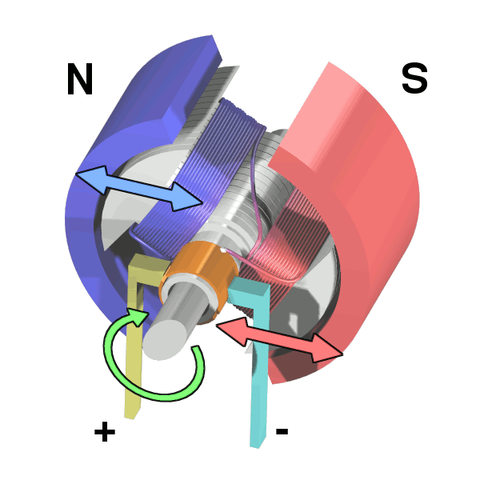
Areas of use of magnets
Magnets are used in many places in everyday life.
Cell phones, electric motors and doorbells work thanks to magnets.
Magnets are used for the construction of electronic devices such as radio and TV sets and computers.
Magnets were used to close the refrigerator doors.
Strong magnets are used for lifting heavy objects.

Slide 5
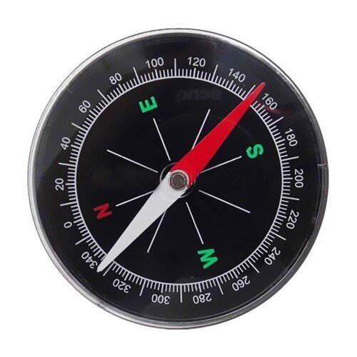
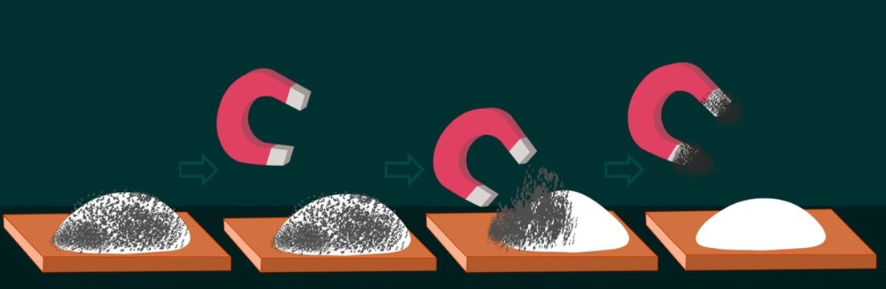
Sailors find their directions in the ocean with a compass (there is a magnet inside the compass).
Magnets are used to separate iron pieces between solid or liquid substances.
Electromagnets are used for cranes to lift heavy loads.
Magnets are used to reach some metal materials in the garbage.
Magnets are used to generate electricity in generators in power plants.
Electromagnets are used in speakers, electric bells and electric cranes and so on.

Slide 6






2022-1-BG01-KA220-SCH-000085065
School subject: Nature Science
Students’Age: 11 years
Topic: Magnets
Credits: Antalya Directorate Of Education
All media are within the EU intellectual property law.
The European Commission’s support for this publication does not constitute an endorsement of the contents, which reflect the views only of the authors, and the Commission cannot be held responsible for any use which may be made of the information contained herein.

